Slide 1


Securing Microservices
WSO2 Identity Server
Anupam Gogoi - Associate Technical Lead

Slide 2
Pre-requisites
JDK 8
Maven
Eclipse or IntelliJ
WSO2 Identity Server 5.7.0

Slide 3
Lab Exercise 1 - Create Microservice
Part 1
We are going to create a simple Microservice in Spring Boot. The service contains a resource protected by OAuth2.
Part 2
Configure WSO2 Identity Server as OAuth2/OpenID authorization server.

Slide 4
Solution Lab Exercise 1
Part 1
Creating a Spring Boot microservice.
Code repository
https://github.com/anupamgogoi-wso2/wso2-summit

Slide 5
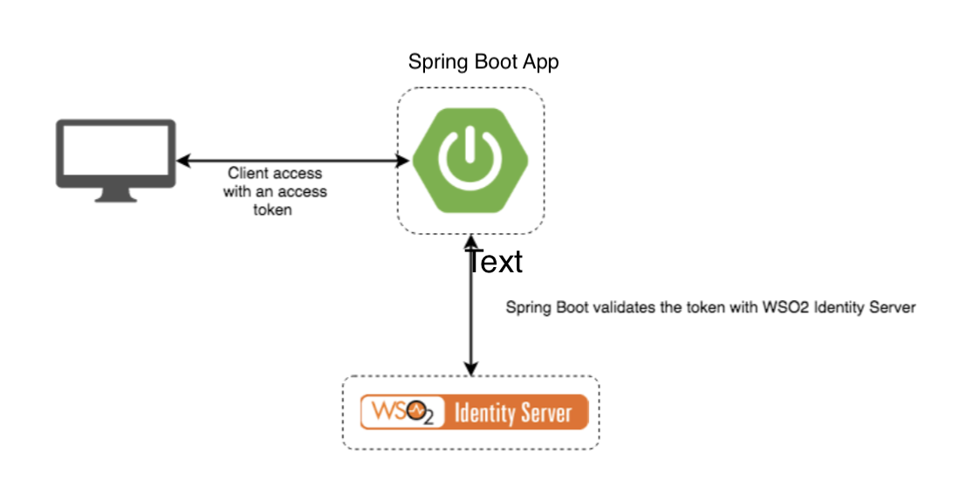
High Level Overview

Slide 6
Spring Boot Microservice
Visit the site https://start.spring.io/ and create a project with dependencies Web and Security.
Import the project in Eclipse/IntelliJ and add one more dependency by hand in the pom.xml
<dependency>
<groupId>org.springframework.security.oauth.boot</groupId>
<artifactId>spring-security-oauth2-autoconfigure</artifactId>
<version>2.0.6.RELEASE</version>
</dependency>
Add your logic.
https://github.com/anupamgogoi-wso2/wso2-summit

Slide 7
Spring Boot - Configure Auth. Server
Note that for client id and client secret you need to use valid username password from WSO2 Identity server.Here i have used default admin username/password.According to this configuration resource server will use OAuth2 introspection API to validate the token.
security.oauth2.client.client-id=admin
security.oauth2.client.client-secret=admin
security.oauth2.client.access-token-uri=https://localhost:9443/oauth2/token
security.oauth2.client.user-authorization-uri=https://localhost:9443/oauth2/token/authorize
security.oauth2.client.scope=openid
security.oauth2.resource.filter-order=3
security.oauth2.resource.user-info-uri=https://localhost:9443/oauth2/userinfo
security.oauth2.resource.token-info-uri=https://localhost:9443/oauth2/introspect
security.oauth2.resource.prefer-token-info=true

Slide 8
Spring Boot - Run
The important thing is to pass client truststore details while executing the jar file.Spring security will use SSL connection to talk with Authorization server to validate the access token.The spring boot runtime should be provided with certificate store to find out the authorization server certificate authority and trust it.
java -Djavax.net.ssl.trustStore=/Users/anupamgogoi/softwares/wso2/is/wso2is-5.7.0/repository/resources/security/client-truststore.jks \
-Djavax.net.ssl.trustStorePassword=wso2carbon \
-jar /Users/anupamgogoi/git/wso2-summit/spring-oauth2-microservice/target/spring-oauth2-microservice-1.0.0.jar

Slide 9
Solution Lab Exercise 1
Part 2
Configure WSO2 Identity Server as OAuth2 Authorization Server

Slide 10
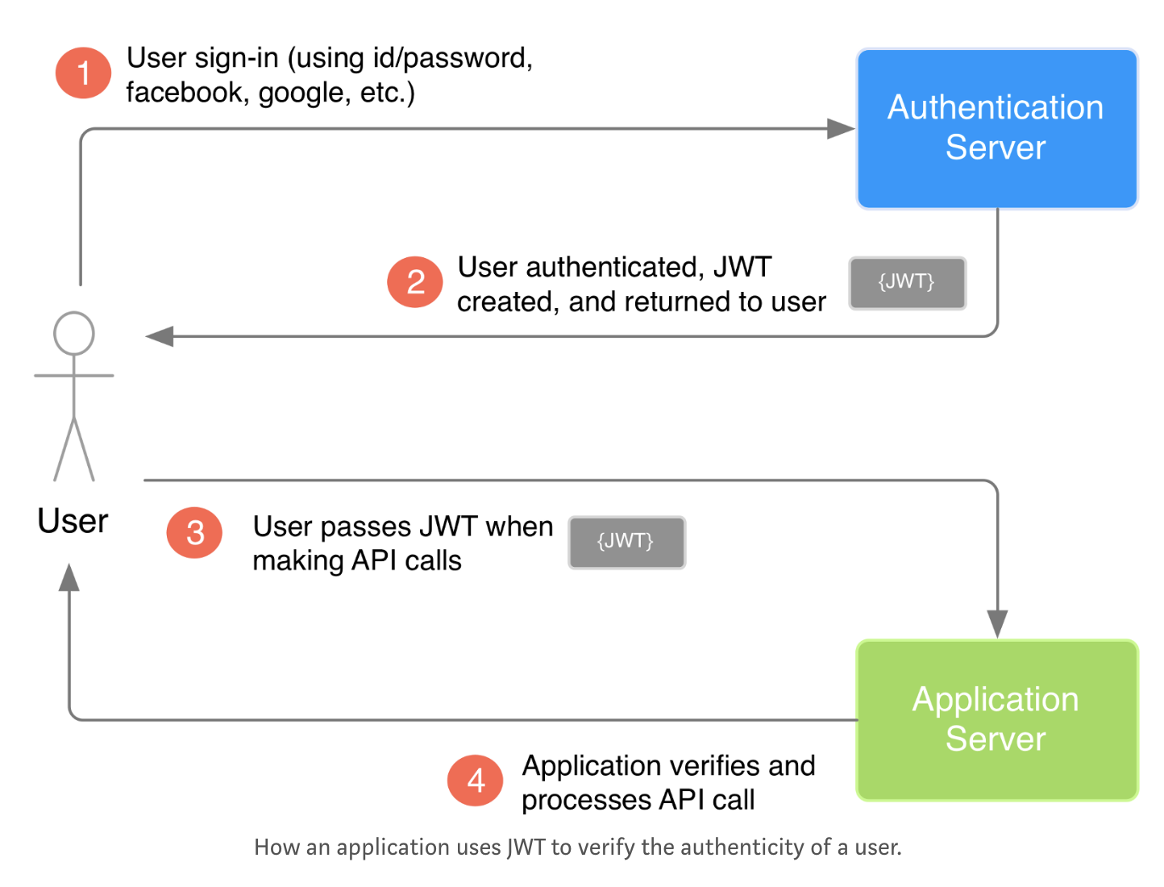
High Level Overview
We will use a simple 3 entity example 1) User, 2) Application server, and 3) Authentication server.
The authentication server will provide the JWT to the user. With the JWT, the user can then safely communicate with the application.

Slide 11
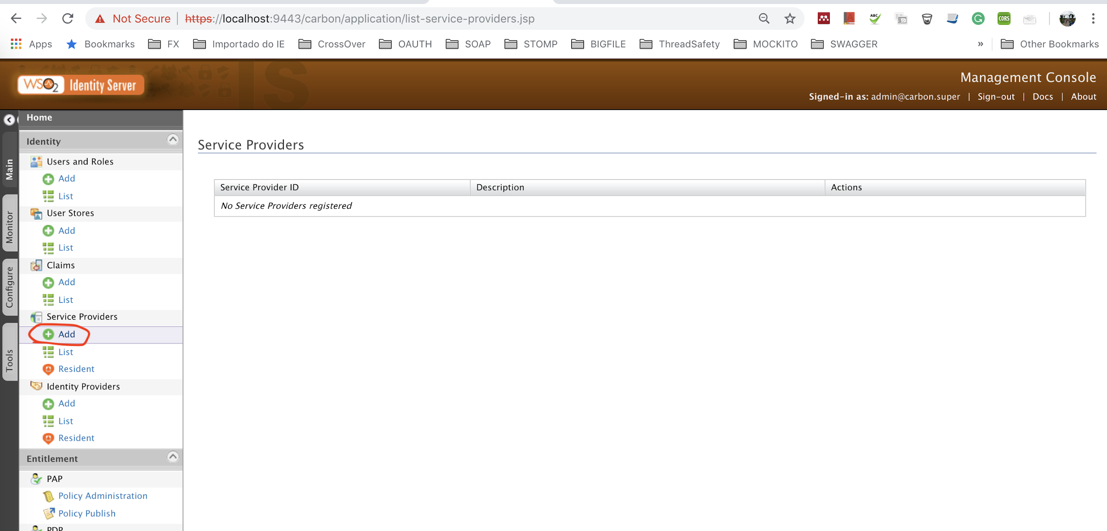
Configure WSO2 Identity Server
Log into the IS (admin/admin)
Navigate to Service Providers menu and click add.

Slide 12
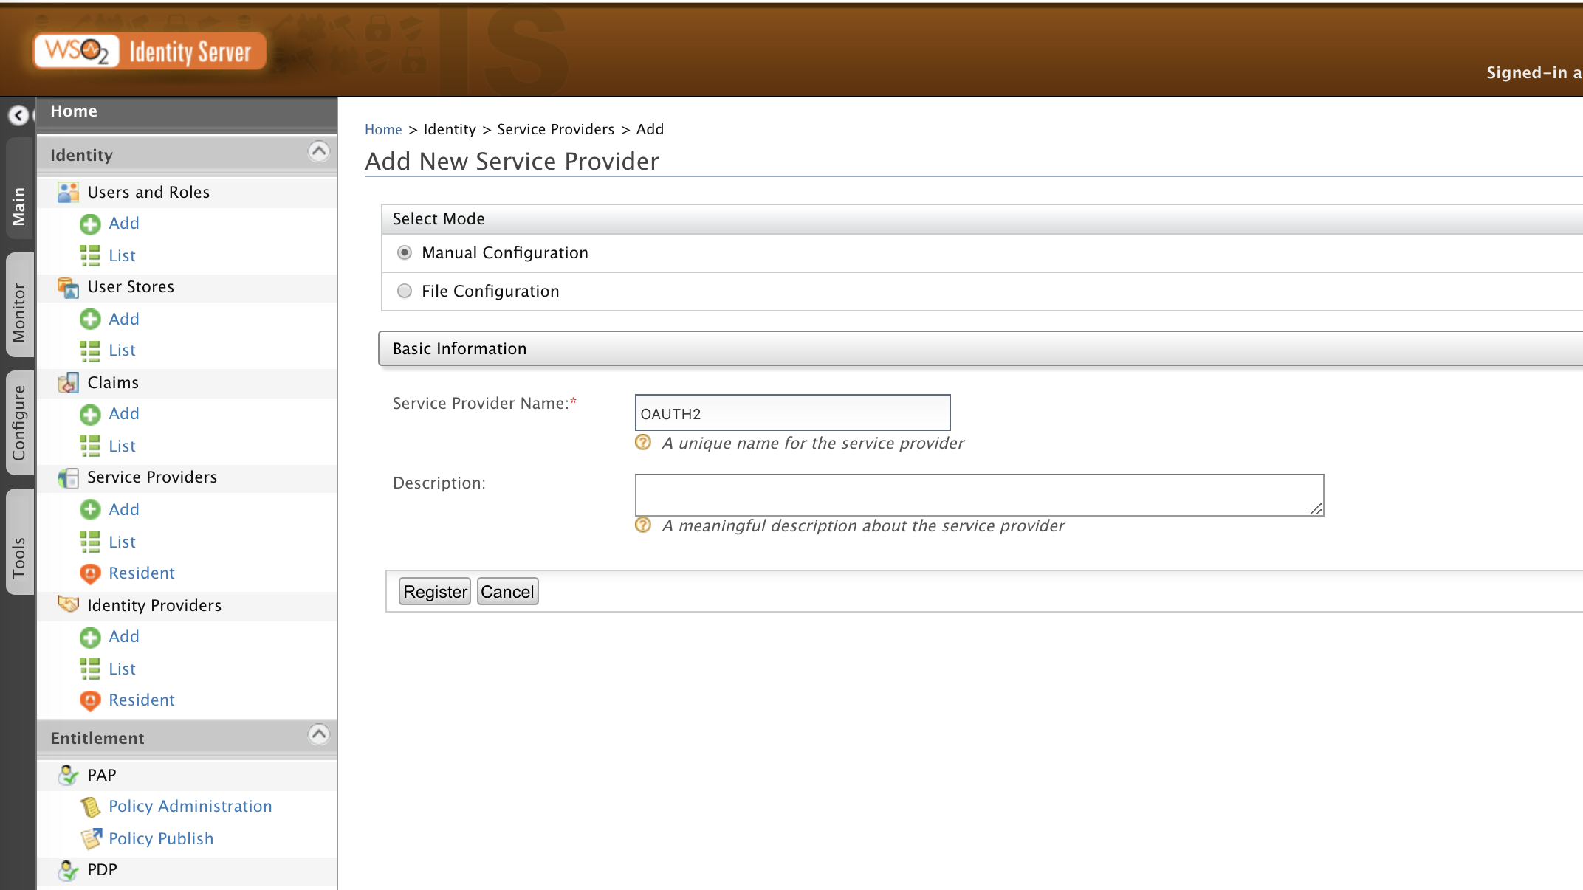
Add Service Provider - IS
Provide Basic Information for the
Service Provider.
Eg.
Service Provider Name: OAUTH2

Slide 13
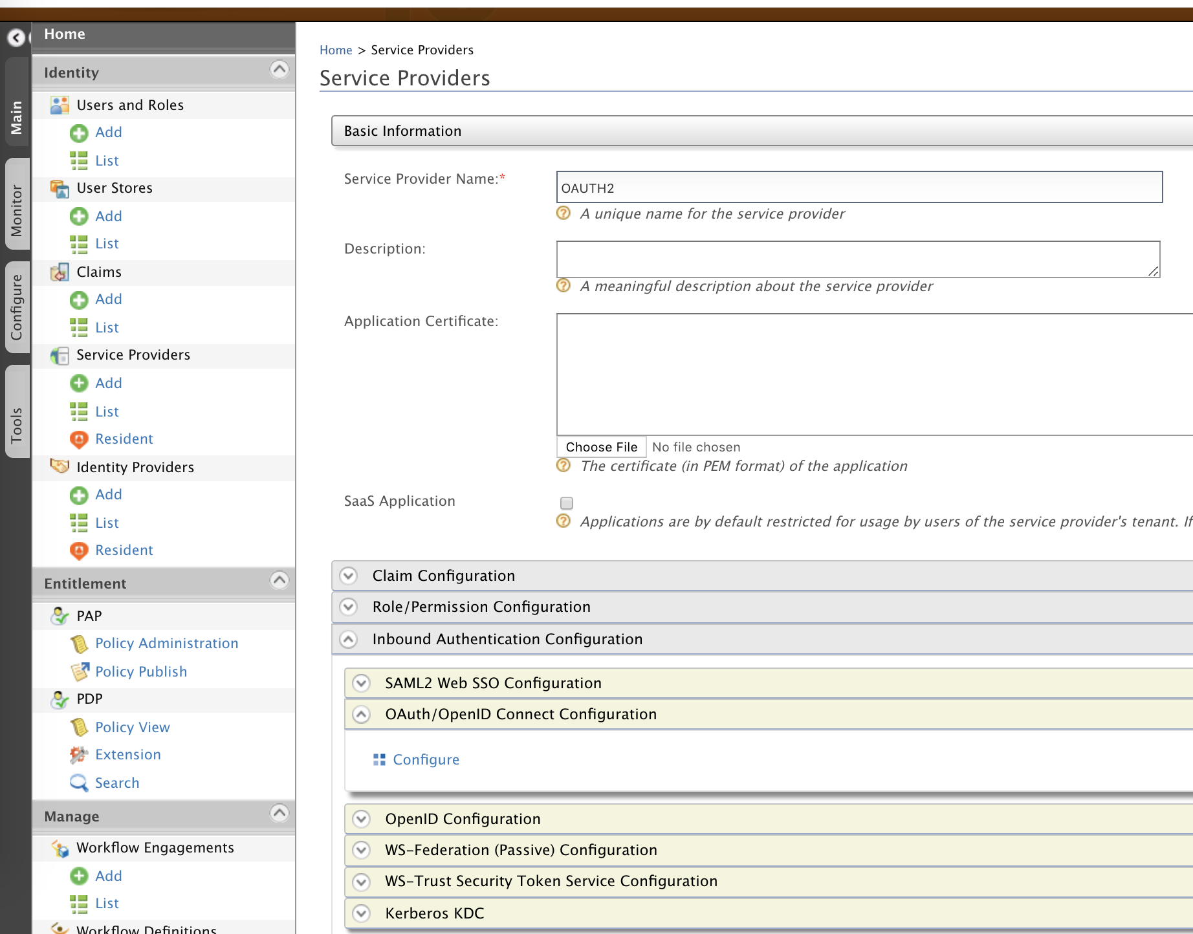
Inbound Authentication Configuration
Click Inbound Authentication Configuration and expand OAuth/OpenID Connect Configuration.

Slide 14
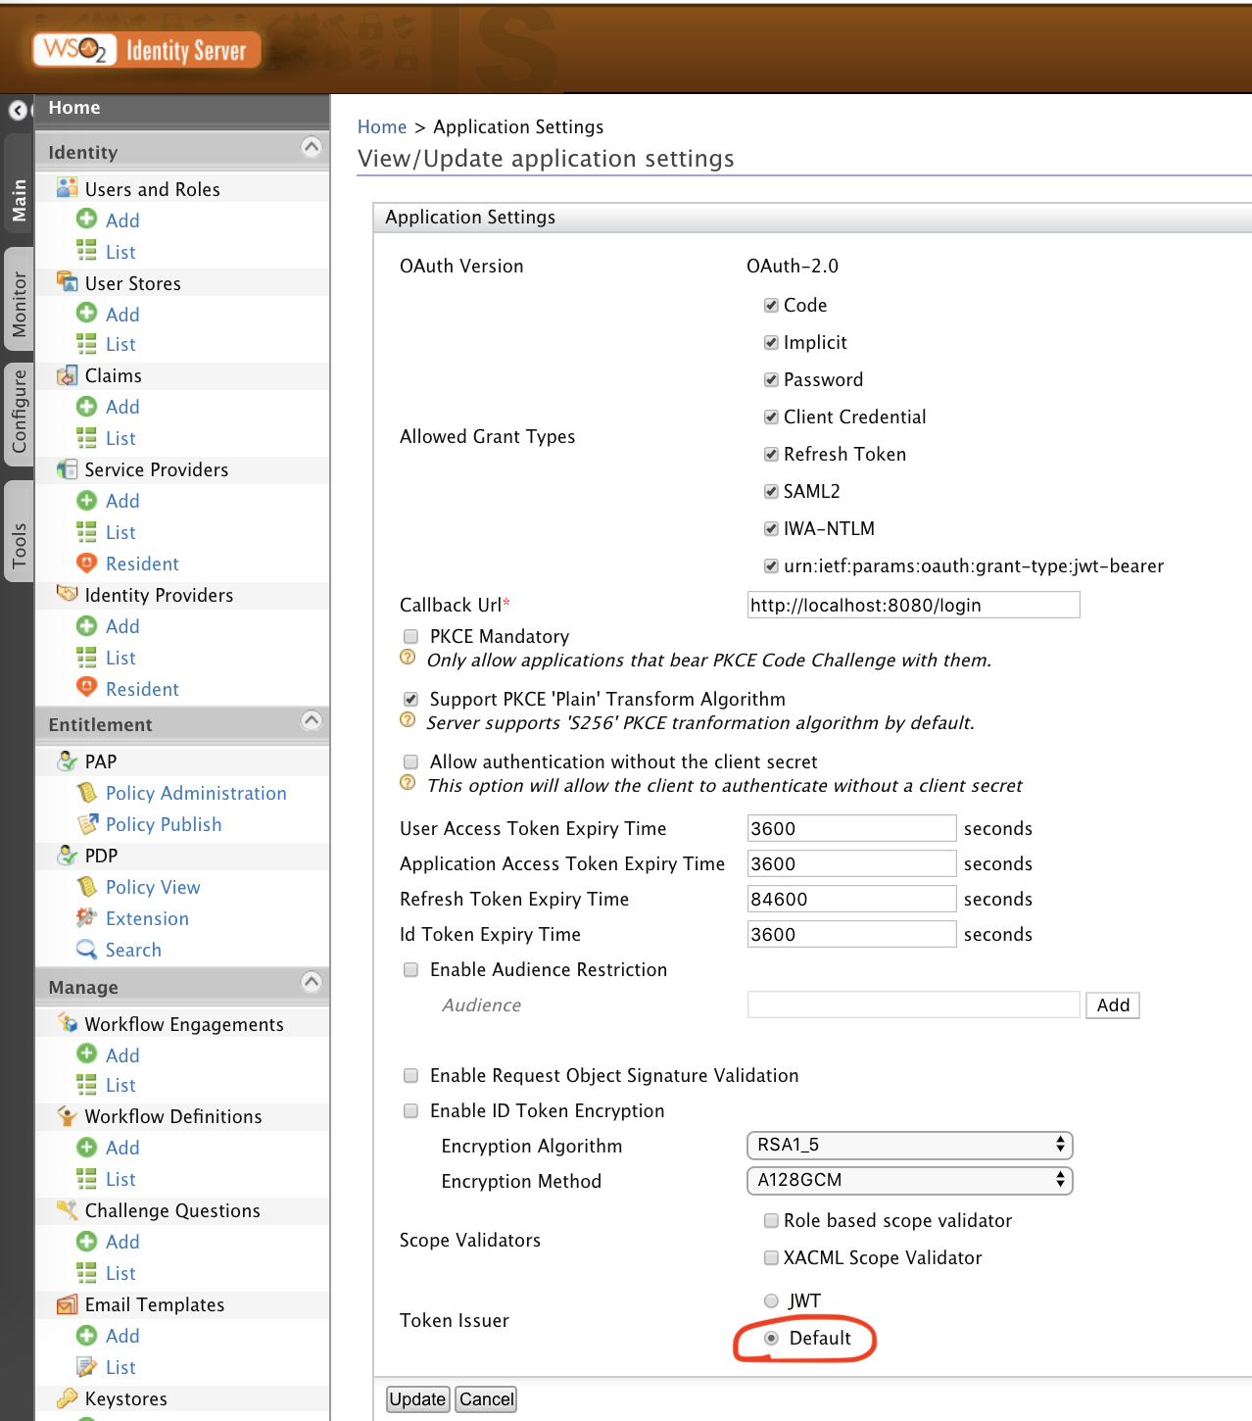
OAuth/OpenID Connect Configuration
Configure OAuth2. Choose Token Issuer as Default (OAuth2).
Note that we can choose JWT also. (Next lab)

Slide 15
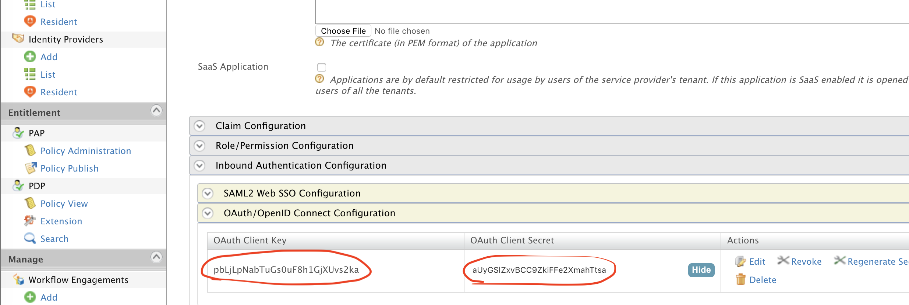
OAuth/OpenID Connect Configuration
Once configuration is saved you will be provided with the Client Key and Client Secret.

Slide 16
Microservice Resource
The Spring Boot microservice contains a resource protected by OAuth2.
GET http://localhost:8080/app/products
To access this resource, an Access Token must be provided in the Authorization header.

Slide 17
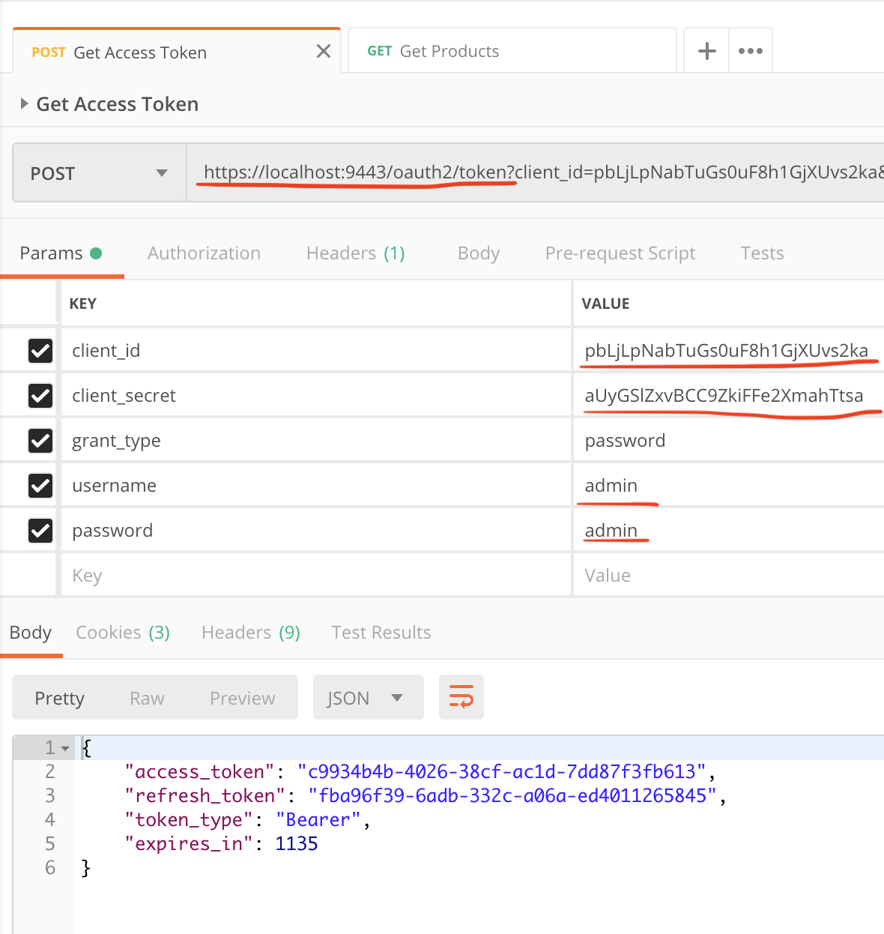
Generating Access Token - Postman
Token URI of the Identity Server,
https://localhost:9443/oauth2/token
Use password grant_type and provide necessary details. Note that the client_id & client_secret are generated while adding the Service Provider in the IS.
Make sure to send the following header,
Content-Type: application/x-www-form-urlencoded

Slide 18
Generating Access Token - CURL
curl -u <CLINET_ID>:<CLIENT_SECRET> -k \
-d "grant_type=password&username=admin&password=admin" -H "Content-Type:application/x-www-form-urlencoded" \
https://localhost:9443/oauth2/token
Invoke Microservice
curl -k http://localhost:8080/app/products -H "Authorization: Bearer <<ACCESS_TOKEN>>

Slide 19
Lab Exercise 2
Using JWT to access the protected resource of the microservice.

Slide 20
Solution - Lab Exercise 2
We are going to use the same Spring Boot microservice with the same resource. Only thing we will need to change is in the Identity Server to generate JWT.

Slide 21
Configure identity.xml - IS
Open the <IS_HOME>/repository/conf/identity/identity.xml file and set the <Enabled> element (found under the <OAuth>,<AuthorizationContextTokenGeneration> elements) to true as shown in the code block below.
Add the following property under <OAUTH> section to use the JWT Token Builder instead of the default Token Builder.
<IdentityOAuthTokenGenerator>org.wso2.carbon.identity.oauth2.token.JWTTokenIssuer</IdentityOAuthTokenGenerator>

Slide 22
Configure identity.xml - IS
Configure the “audiences” parameter as mentioned below so that the token includes information about the intended audiences who can use the generated token for authenticating the user.
<EnableAudiences>true</EnableAudiences>
<Audiences>
<Audience>${carbon.protocol}://${carbon.host}:${carbon.management.port}/oauth2/token</Audience>
</Audiences>
Configure a meaningful value to the <IDTokenIssuerID> parameter in the identity.xml file
<IDTokenIssuerID>my-jwt-token</IDTokenIssuerID>
Start the IS
sh wso2server.sh

Slide 23
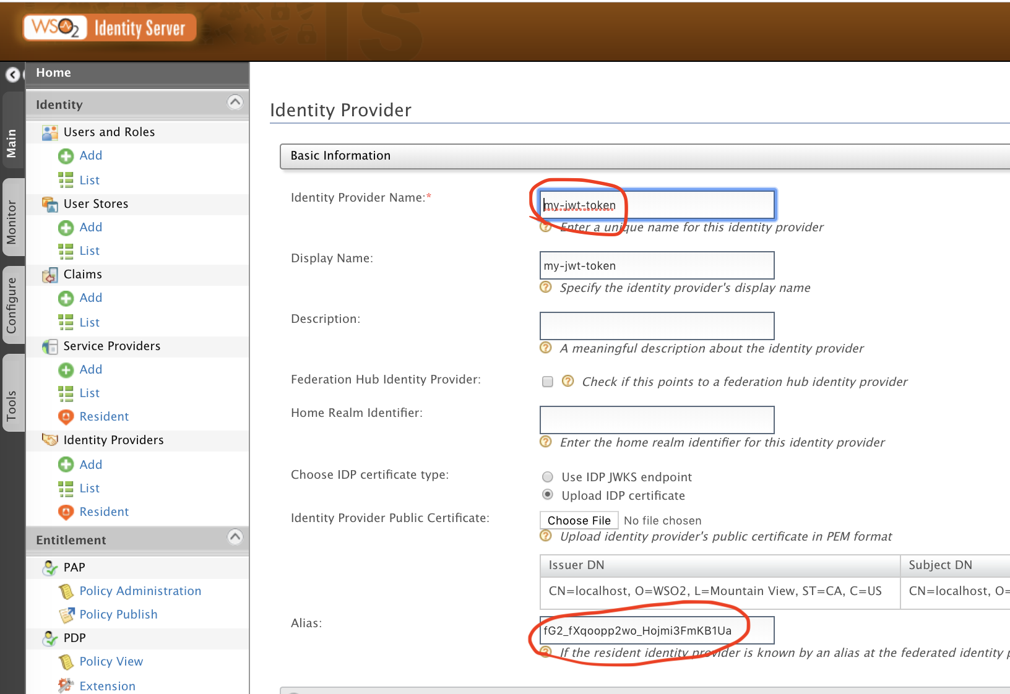
Configure Identity Provider - IS
Go into Identity-> Identity Providers and click on “Add”.

Slide 24
Configure Identity Provider - IS
Identity Provider Name — This needs to be the same value as the <IDTokenIssuerID> value you configure at the identity.xml file since this value will be the issuer ID of the JWT token. Here the value is given as “apim-idp” to match the above mentioned parameter.
Identity Provider Public Certificate — Here you need to upload the public certificate of the WSO2 Identity Server in a pem file format. The Identity Provider Public Certificate is the public certificate belonging to the identity provider. Uploading this is necessary to authenticate the response from the identity provider. This can be any certificate. Since we are using WSO2 Identity Server as the IDP we can generate the certificate using the below mentioned commands.

Slide 25
Create/Import Certificate
Open your Command Line interface, go to the <IS_HOME>/repository/resources/security/directory. Run the following command.
keytool -export -alias wso2carbon -file wso2.crt -keystore wso2carbon.jks -storepass wso2carbon
Click Choose File and navigate to this location in order to select and upload this file.
Alias — You need to give the clientID (client key) of the service provider which you will configure in the WSO2 Identity Server here. This will be checked when verifying the JWT token.

Slide 26
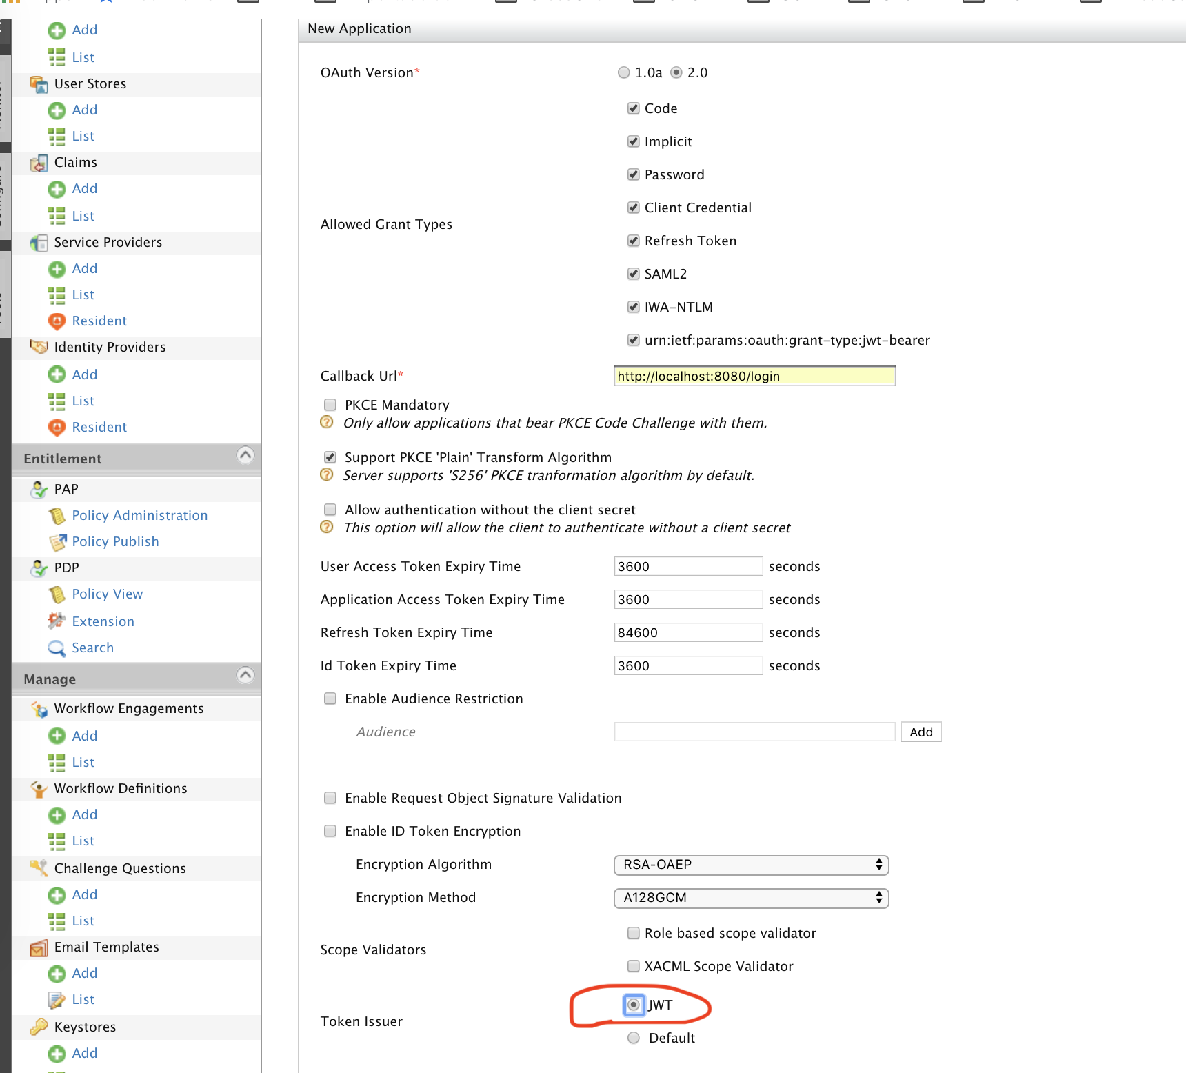
OAuth/OpenID Connect Configuration
Create a new Service Provider e.g JWT
Choose any valid Url in the Callback Url field.
Choose Token Issuer as JWT.

Slide 27
Get JWT & Invoke Service
You need to first get a JWT token from the WSO2 identity server by using the token endpoint with the password grant type. You can use the below mentioned curl command to get a JWT token,
curl -u <CLIENT_ID>:<CLIENT_SECRET> -k \
-d "grant_type=password&username=admin&password=admin" -H "Content-Type:application/x-www-form-urlencoded" \
https://localhost:9443/oauth2/token
Use the token in Authorization header in the request to access the protected resource of the microservice,
curl -k http://localhost:8080/app/products -H "Authorization: Bearer <<JWT_TOKEN>>"

